Slide 1




NeRF-Augmented Training of
Vision Transformers
Supervisor
Professor, PhD. Darabant Sergiu Adrian
Author
Pop Denis-Vasile

Slide 2
Overview
01
Introduction
02
NeRF-Based Data Generation
03
Experiments with Tiny RoMa
04
Experiments with Depth-Anything-V2
05
Demo Application
06
Conclusions

Slide 3
Introduction

Slide 4
Context
Understanding 3D scene structure is crucial in computer vision for robotics, AR, and autonomous systems.
Two key tasks:
Depth Estimation – predicting object distance from one or more images
Feature Matching – finding correspondences between images for tracking or reconstruction
ViTs (e.g., Tiny RoMa, Depth-Anything-V2) have advanced these tasks, but they require large, diverse, high-quality datasets.

Slide 5
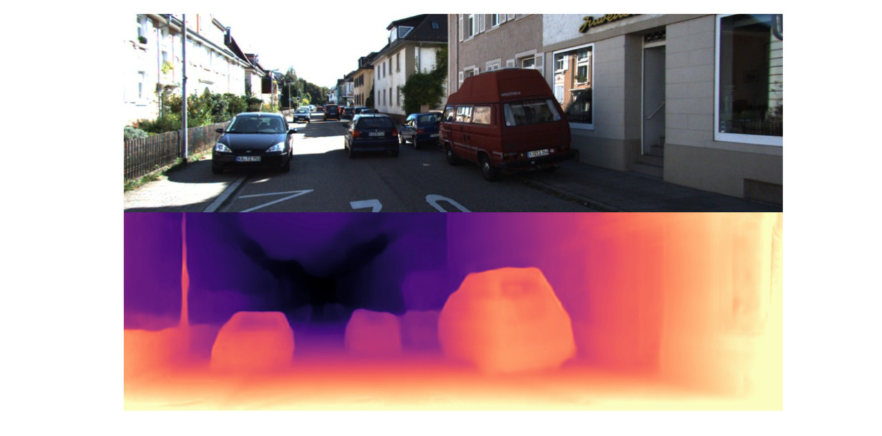

Slide 6
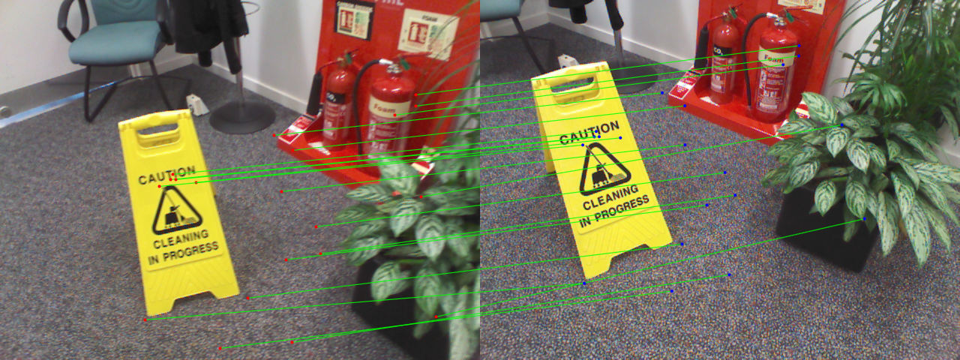

Slide 7
Motivation
Collecting large, labeled RGB-D datasets is costly and often impractical, limiting the training of vision models.
NeRF can generate realistic synthetic images and depth maps from just a few input views, offering a scalable alternative.
Vision Transformers need diverse data to perform well. This work explores whether NeRF-generated data can boost their performance.

Slide 8
Objectives
Generate synthetic RGB-D data using NeRF
Fine-tune and evaluate:
Tiny RoMa for dense feature matching in stereo images.
Depth-Anything-V2 for monocular depth estimation.
Create an app that allows the user to interact with the fine-tuned models

Slide 9
State of the Art & Related Work
RoMa, Edstedt, CVPR 2024
Depht-Anything-V2, Yang, CVPR 2024
NeRF-Supervised Deep Stereo, Tosi, CVPR 2023

Slide 10
NeRF-Based
Data Generation

Slide 11
NeRF: Neural Radiance Fields
How It Works?
Learns a 5D function: maps 3D points + view direction → color & density
Uses volume rendering to integrate samples along camera rays
Needs accurate camera poses and multiple input images for training

Slide 12
Data Sources
RGB-D Dataset
7-Scenes
The NeRF-Stereo Dataset
Raw Data
Indoor RGB-D sequences from a Kinect camera (640×480)
7 scenes, each with 500–1000 frames
Includes RGB, depth, and camera poses via KinectFusion
270 scenes (indoor & outdoor)
~100 RGB images per scene
Camera poses estimated with COLMAP

Slide 13
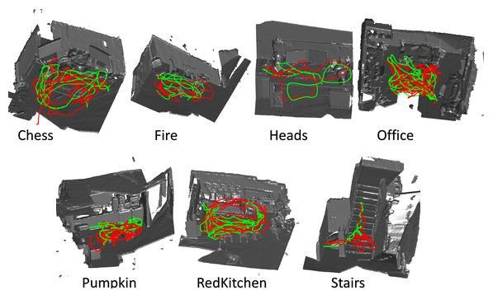
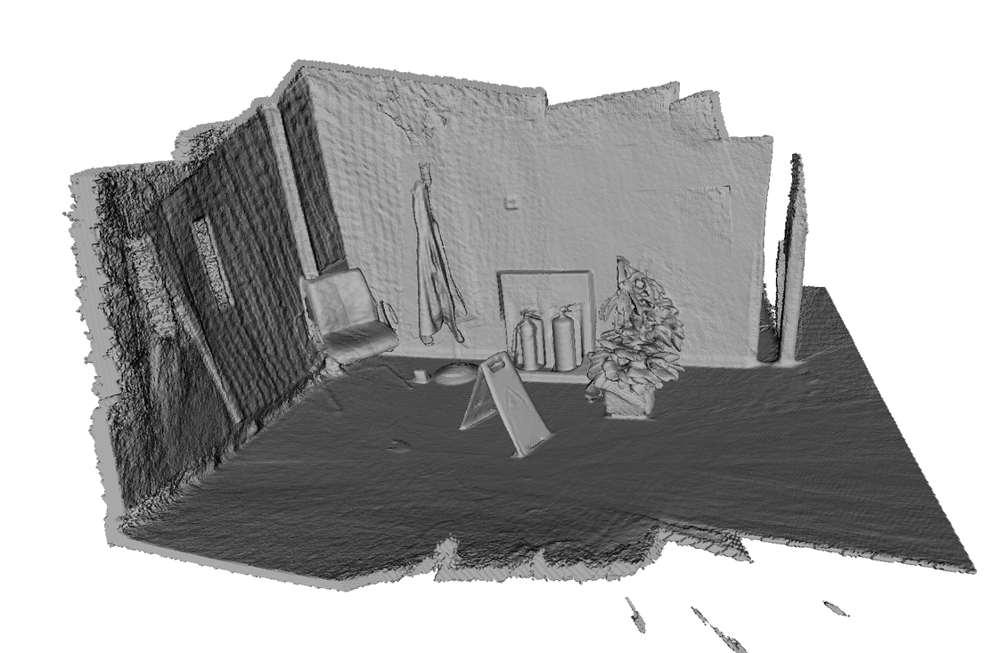
RGB-D Dataset 7-Scenes
All Scenes
Fire Scene Preview

Slide 14
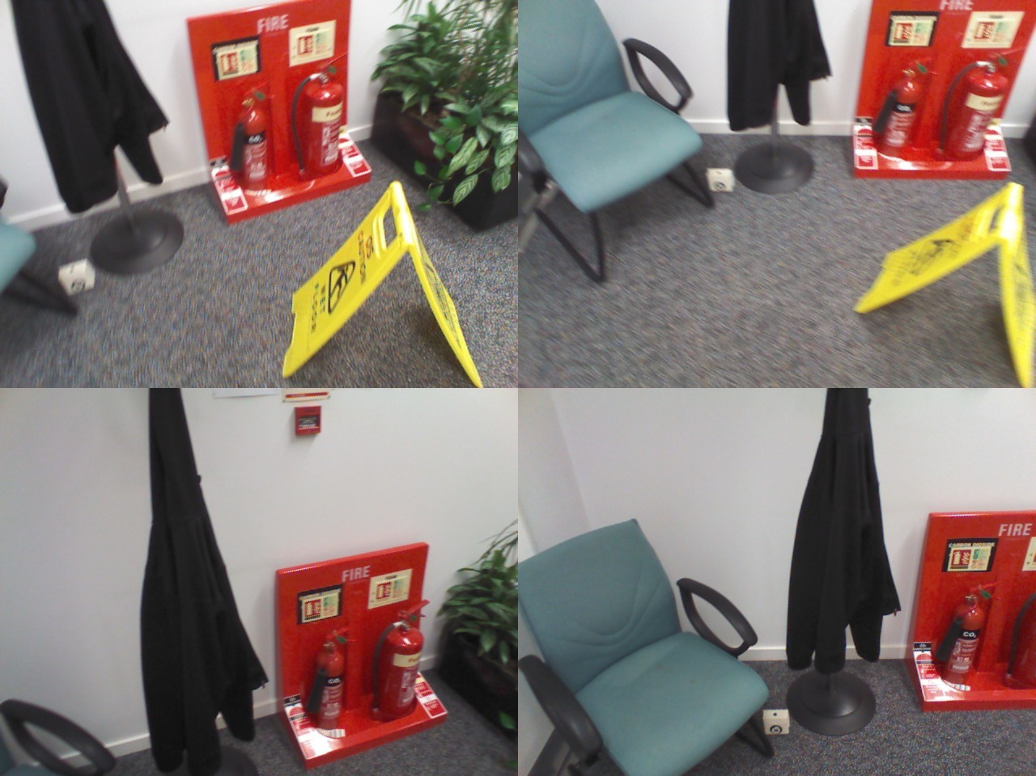
Fire Scene Preview

Slide 15
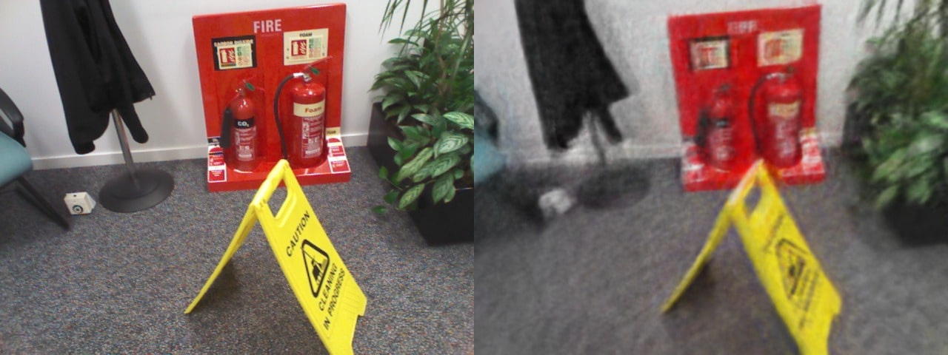
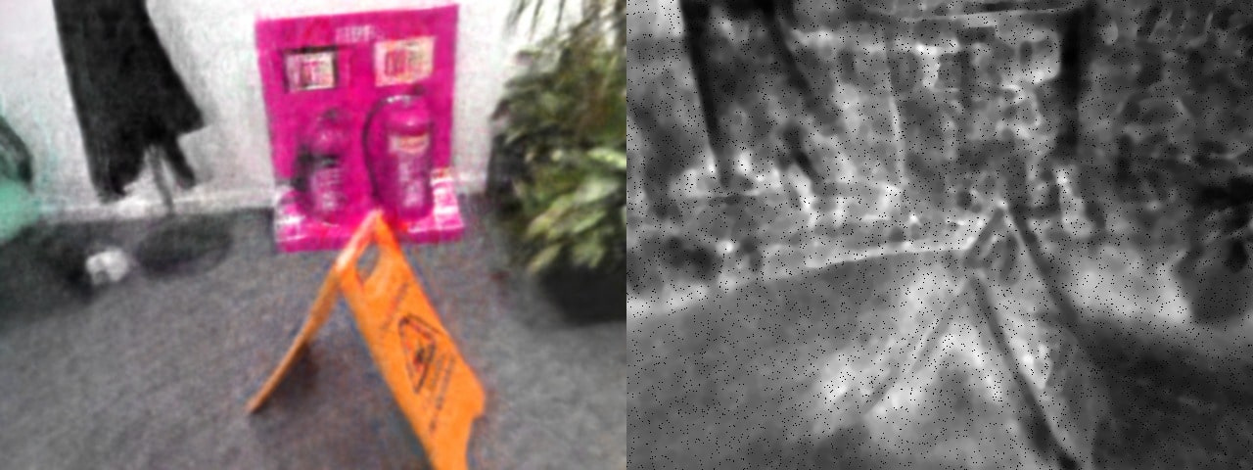
Original
NeRF-Generated
Augmented RGB
Augmented Depth

Slide 16
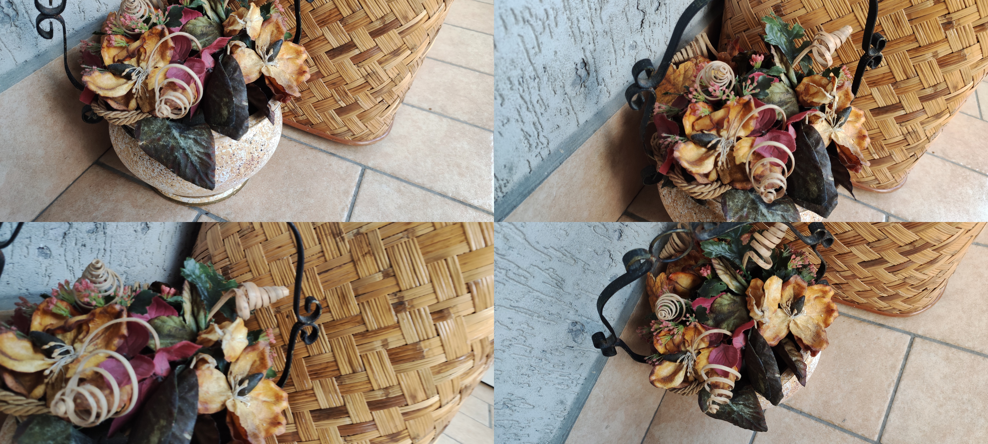
The NeRF-Stereo Dataset
Scene 0080 Preview

Slide 17


Augmented RGB
Original
Augmented Depth

Slide 18
7-Scenes:
NeRF-Augmented Data
NeRF-Stereo:
Fully Synthetic Data
5 scenes partially augmented with NeRF data
50 rendered frames per scene
NeRF made up 0.8%–10% of training data
Combined real and synthetic RGB-D frames
Used scenes 0080 and 0097
100 fully synthetic frames per scene
High-quality NeRF renders for standalone training

Slide 19
Experiments
Tiny RoMa

Slide 20
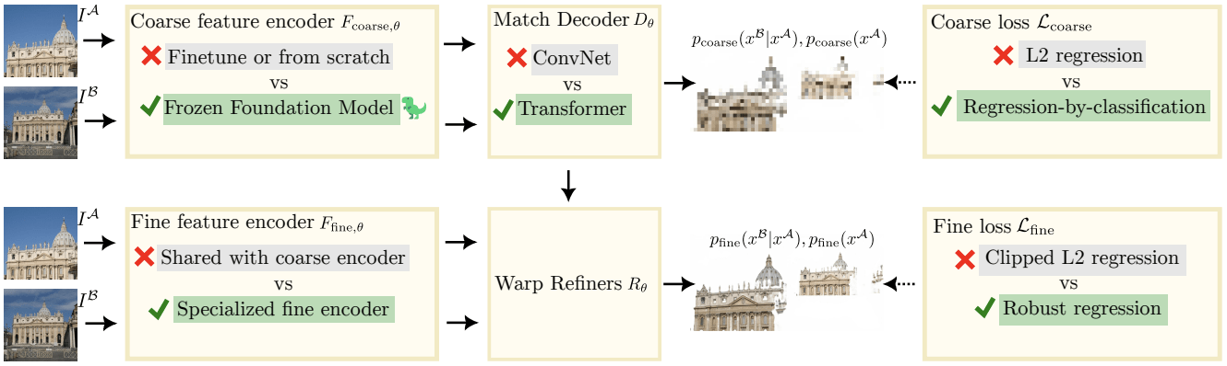
RoMa & Tiny RoMa
Tiny RoMa:
Retains the core logic of RoMa but replaces the heavy backbone with lightweight CNN blocks
Compact Encoder based on XFeat
Reduces the number of attention layers and parameters

Slide 21
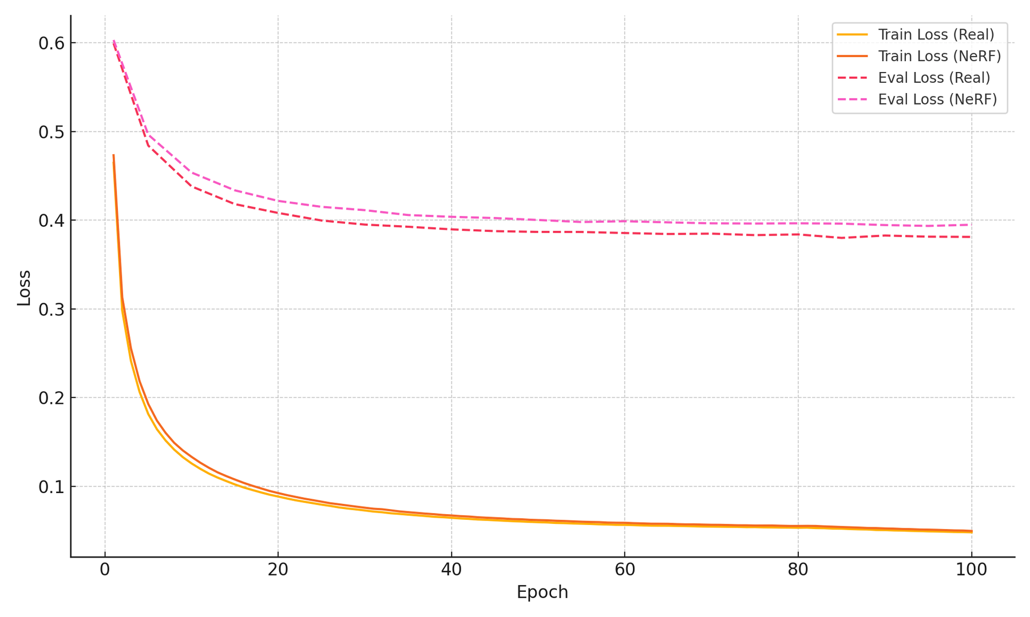
Training and Evaluation Loss
Augmented Fire Scene

Slide 22
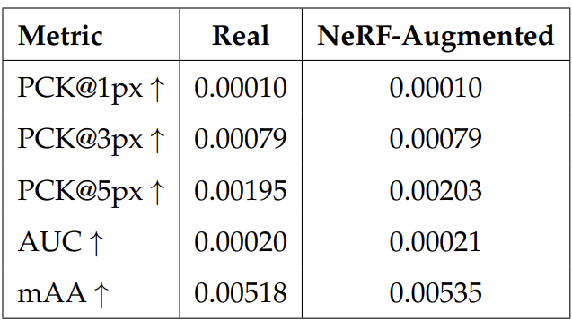
Performance Metrics
Augmented Fire Scene

Slide 23
Experiments
Depth-Anything-V2

Slide 24
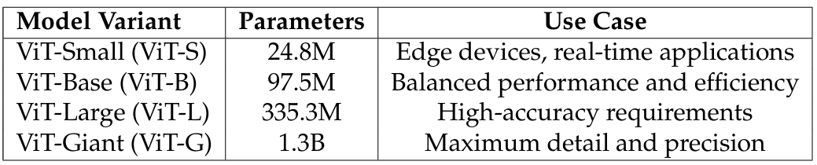
Depth-Anything-V2
DINOv2 ViT Encoder
ViT-Small(ViT-S): 24.8 million parameters
ViT-Base (ViT-B): 97.5 million parameters
ViT-Large (ViT-L): 335.3 million parameters
ViT-Giant (ViT-G): 1.3 billion parameters
Dense Prediction Transformer (DPT) Decoder
Combines scale and shift-invariant loss with gradient matching loss

Slide 25
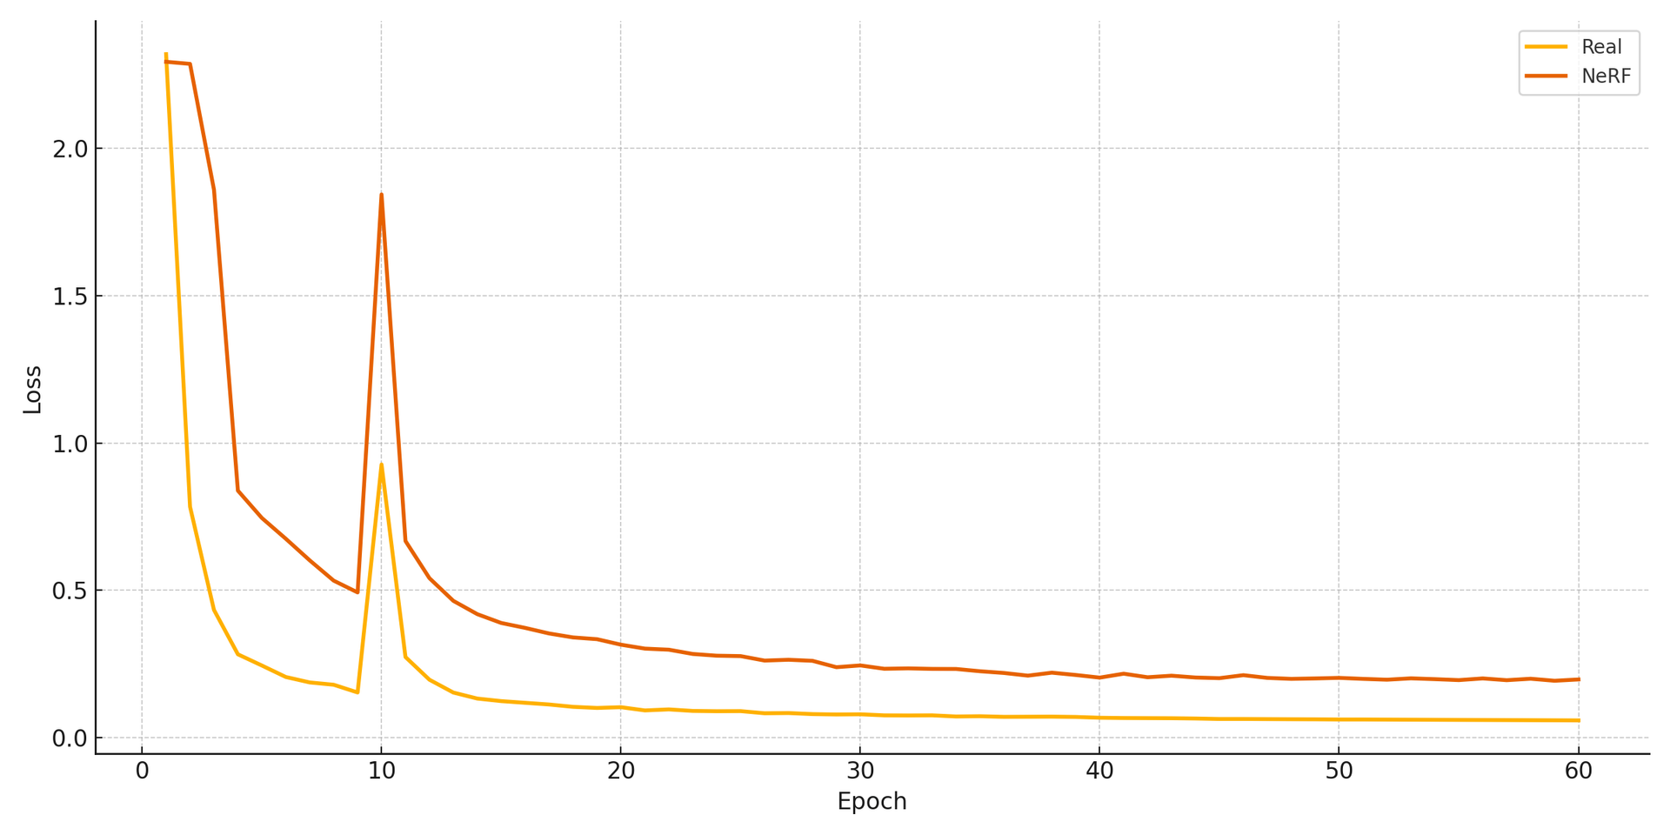
Training and Evaluation Loss
Augmented Fire Scene

Slide 26
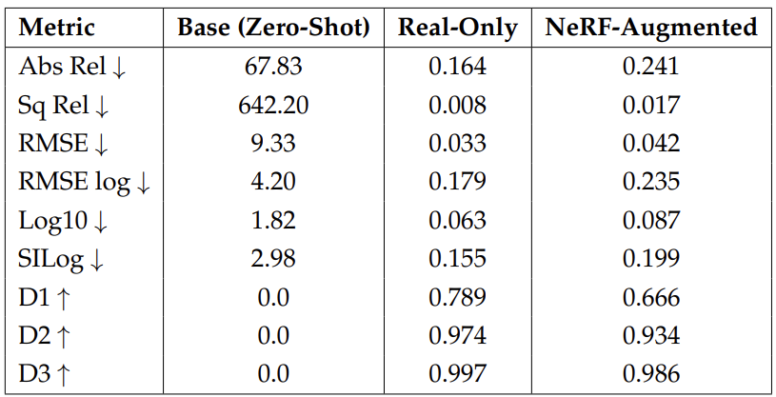
Performance Metrics
Augmented Fire Scene

Slide 27
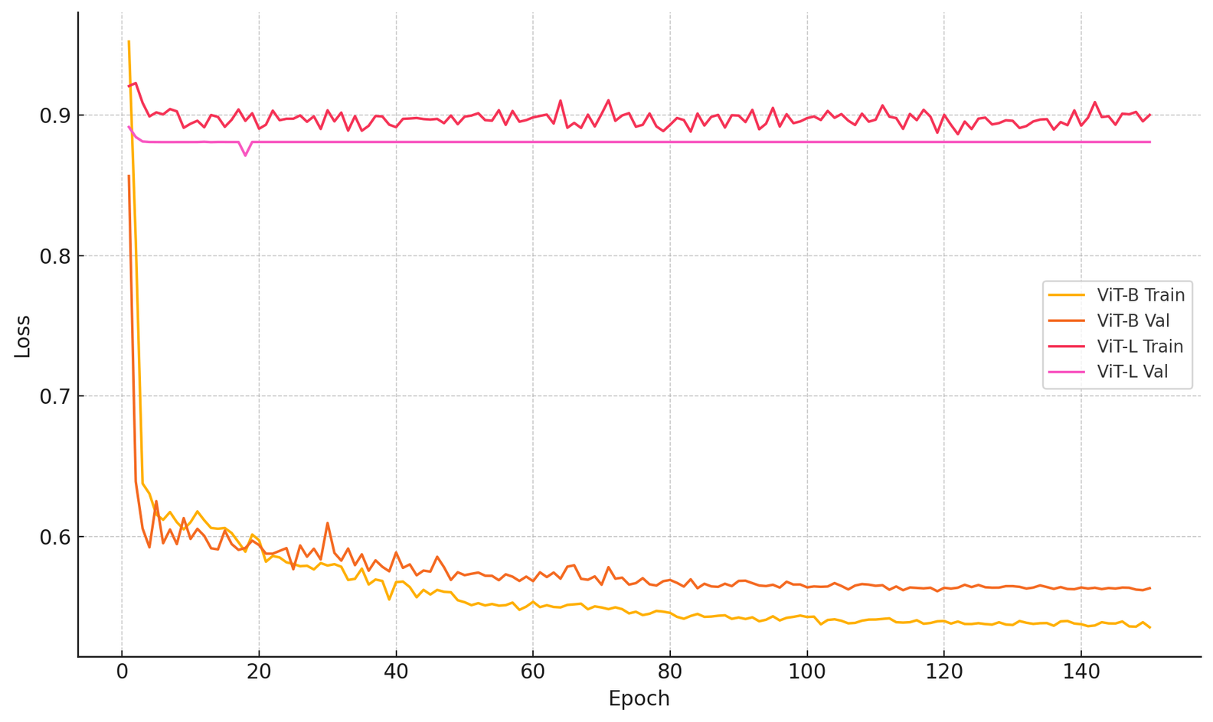
Training and Evaluation Loss
Synthetic 0097 Scene

Slide 28
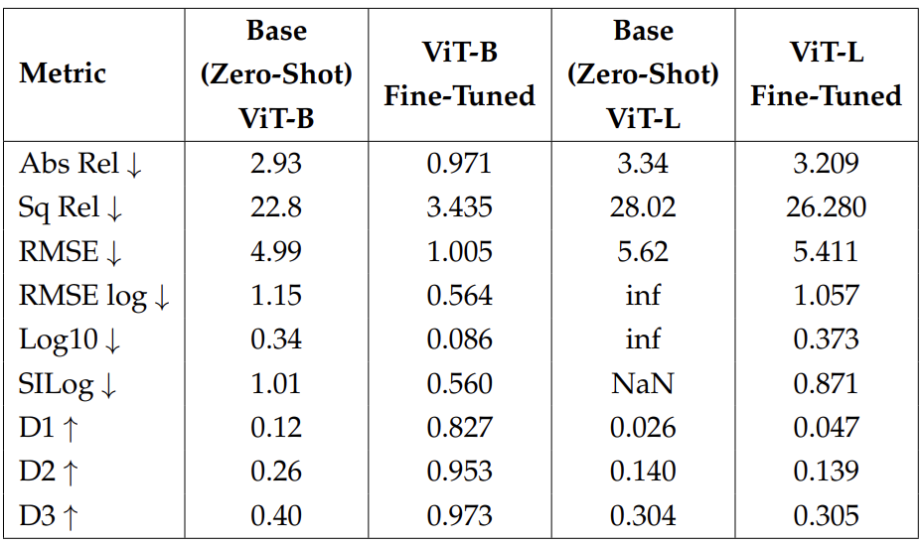
Performance Metrics
Synthetic 0097 Scene

Slide 29
Demo Application

Slide 30
Full-Stack App
FastAPI Backend
React Frontend
REST APis to:
Load different models
Get current selected model
Run inference
Keep in memory 2 models loaded and switch between fine-tuned weights
Additional Gradio app for easy debug
30 tests with pytest
React + Vite with Typescript & SWC
MUI Components for clean interface
Axios API calls
React Router DOM routing
20+ tests (ui, utility and api) with vitest

Slide 31
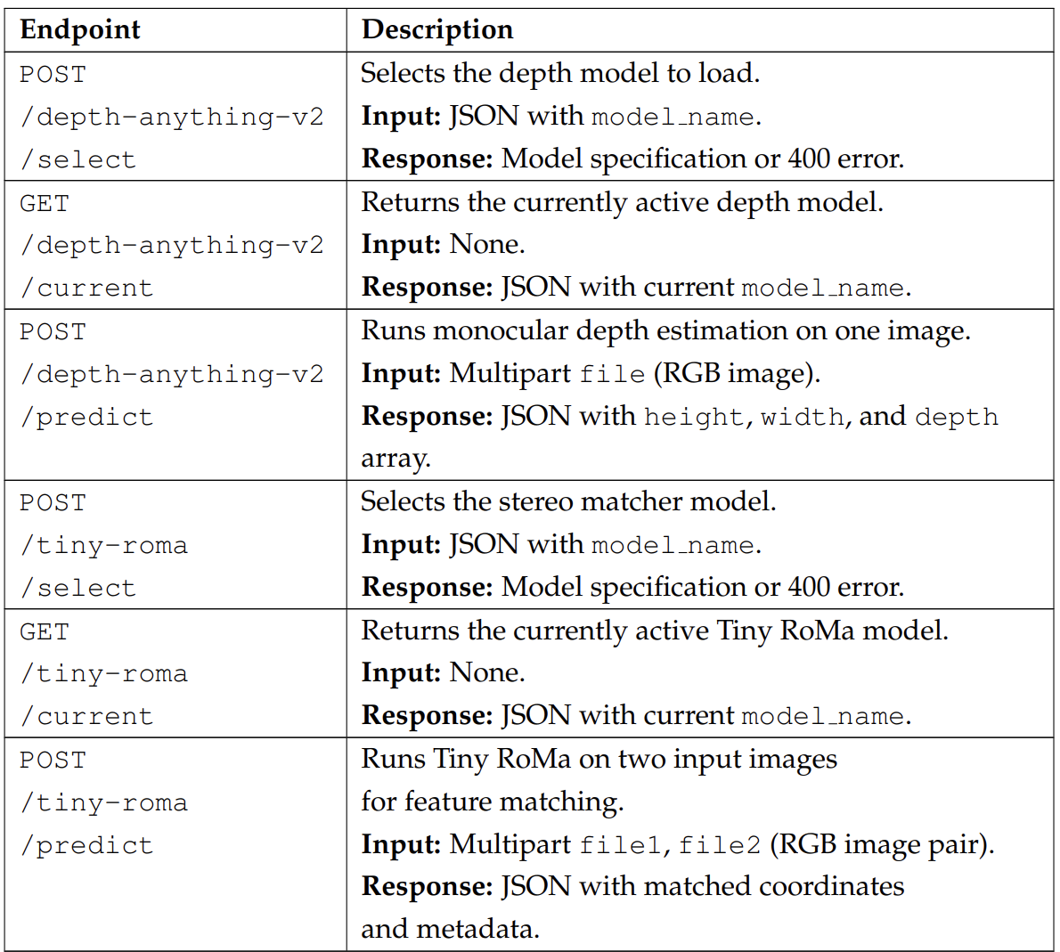

Slide 32
Conclusions

Slide 33
NeRF-generated data: nuanced effects on performance
Partial augmentation: neutral to slightly positive impact
Tiny RoMa model
+15% NeRF frames → improved coarse keypoint matching
No degradation in fine-grained performance
Depth-Anything-V2 model
Accuracy dropped with same NeRF augmentation
Sensitive to inconsistencies from synthetic frames
Overall takeaway
NeRF better for augmentation than full training
Performance depends on:
Model size (e.g., Tiny vs. Large ViTs)
Task type (e.g., feature matching vs. depth estimation)
Synthetic-to-real data ratio

Slide 34
Personal Contributions
Created partially and fully synthetic datasets combining real and NeRF-rendered RGB-D frames from the 7-Scenes and NeRF-Stereo datasets.
Fine-tuned and evaluated Tiny RoMa and Depth-Anything-V2 on both partially and fully synthetic datasets.
Implemented of a full-stack application with FastAPI and React for interactive model inference and visualization.

Slide 35
Thank
You

